Slide 1

Annual Report to the County Board from the
County Executive
Darlene A. Kloeppel, County Executive
May 19, 2022

Slide 2
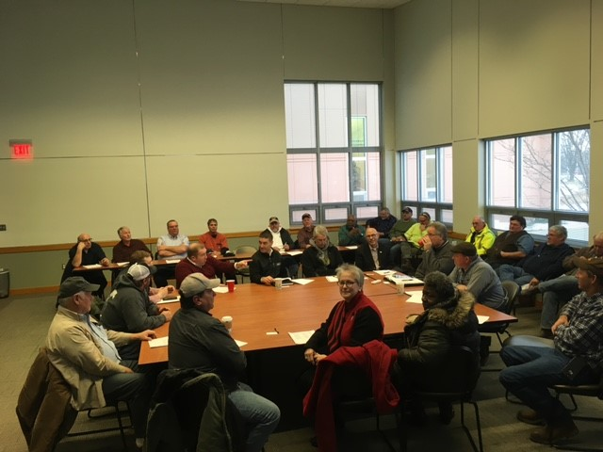
- County Governance
County Offices
Complete turnover on Board of Review in Sept 2021
Merger of County Clerk & Recorder offices in Dec 2021
Redistricting of County Board seats finalized in Dec 2021

Slide 3
County Finances –
2022 budget
Mushrooming county budget
2022 - $179,767,329
2021 - $136,939,369
2020 - $129,689,501
2019 – $122,974,563
Up $55m
46% in 4 years
Budget Impacts
COVID-related grants (CARES/CURE/ARPA)
Increase in cannabis & on-line sales taxes
Increase in motor fuel tax/rising fuel costs
New animal control contracts & fee schedule
Increase in revenue stamps
Reduction in court fees/fines
Large expenditures:
  ARPA purchases
  roof/air conditioning unit replacement
  OT , hiring bonuses, and salary adjustments due to staff vacancies
  out of county boarding for jail inmates
5-7% cost increases for commodities

Slide 4

County Finances – balancing the budget
Progress on reducing NH Liabilities
Received last $110,000 from NH purchase escrow holdback in 2022
Completed last NH legal settlement in 2022
County still waiting on state audit for any last accounting reconciliation between county & NH
Reallocated FY2022 NH Property Tax Levy of $950,000 to pay back the Tort Immunity Fund for NH Self-funded Workers’ Comp Ins claims
$4.8m still owed from NH to other county accounts
Potential revenue-generating strategies
Add solar panels to county’s flat roofs to reduce ongoing utility costs – research in progress
Liquor license fee – last updated in 2005; county currently much lower than City of Champaign; difficult recent 2 years for bars
Gaming machine license fee – county doesn’t currently have fees in this allowed category
Operate a “community garden” at the jail to provide both outdoor activity and fresh food

Slide 5
American Rescue Plan Act investments - $21m in 2022
County Department Projects
ARPA project management
County jail – full body scanner and COVID testing
EMS mobile command vehicle
Cybersecurity, county records digitization and IT system upgrades
County employee premium pay
Election equipment
County Plaza purchase
Circuit Court and Circuit Clerk’s Office technology & partitions
State’s Attorney’s video evidence management system
Sheriff’s community outreach activities
Head Start Early Childhood facility
Community Initiatives
Mental health services
Winter low-barrier emergency shelter
Mortgage, rent & sewer bill arrearage assistance
Immigrant services for language access and mental health
Rural housing rehabilitation
Countywide broadband coverage
Mahomet Aquifer mapping & hazardous waste collection project
Rural water/sewer/drainage & crop cover projects
Housing stability – Family Emergency Shelter renovations
Community violence prevention (projects to be determined)
Small business assistance (projects to be determined)

Slide 6
Economic development investments/partnerships
Participation in Champaign, Fisher, Homer, Mahomet, St. Joseph & Urbana TIF Districts
Partner with Douglas County and Urbana Enterprise Zones
Extended industrial bond support for Countryside School
Purchased and planning renovation of County Plaza in downtown Urbana
Funded ARPA broadband, water infrastructure, housing and workforce development projects
Corporate memberships in
  Champaign County Economic Development Corporation
  Visit Champaign County
  Champaign County Chamber of Commerce
Partner in
  Champaign County Regional Planning Commission
  Metropolitan Intergovernmental Council
  Champaign County First Coalition
  Willard Airport Advisory Committee
  Central Illinois Land Bank Authority

Slide 7




County Workforce
growing number of staff vacancies became critical for several departments (47 positions / 9% of county jobs vacant overall in April 2022; majority are justice-related)
taking longer to negotiate bargaining unit contracts
partially remote work became an option for many department staff (likely to remain)
becoming harder to obtain consultants for expertise on the county’s special projects
adding mandates for personnel (sexual harassment training, COVID-19 testing)
added sign-on bonus for sheriff’s deputies
added salary increases for officer lateral move transfers
added 8 staff positions (public defender, coroner, sheriff, animal control, zoning & IT)
cost of time off increased – 3 winter weather days; extra election day holiday; OT pay to cover vacancies
used ARPA funds for employee premium pay
proceeding with county workforce study

Slide 8
County Facilities–
remodel of Animal Control, Circuit Clerk, Public Defender & CCRPC to increase distancing and increase workstations
replacement of roofs/HVAC from 2020 hail damage still in progress
finally in progress on jail consolidation
purchase County Plaza & in progress on renovation design phase
On the horizon –
demolition of old nursing home (2022)
future of humane society facility (2023)
relocation of county offices to County Plaza (2024)
future uses for Brookens facility (2024)
demolition/future of downtown jail property (2024)

Slide 9


County IT
ERP implementation in progress
  accounting modules rolled out Jan 2022
  payroll/timekeeping in progress
  budgeting for 2023
  HR performance mgmt. to come
2-factor authentication rolled out Jan-April 2022 to improve cybersecurity
implementation of law enforcement data management system upgrade (shared with municipalities)
began expansion of State’s Attorney video evidence mgmt. capability
technology changes increasing on-line notification & applications for services, payment options, vote by mail, etc.
digitization of county records

Slide 10
Other issues on the radar -
supply chain delays in purchasing/ contracting accompanied by huge price increases
new unfunded mandate to track/report minority/women-owned/veteran status of all vendors/subcontractors
management of number of “special projects” in progress – staff is stretched with additional meetings, legal issues, reporting, public relations activities
The board reduced the incoming Executive’s salary from $122,00 to $70,000, while giving all other countywide elected officials significant raises – is the intention to make this a part-time position?
  (League of Women Voters study recommendations on county governance structure relating to Executive, Auditor, Coroner also will be out soon)

Slide 11
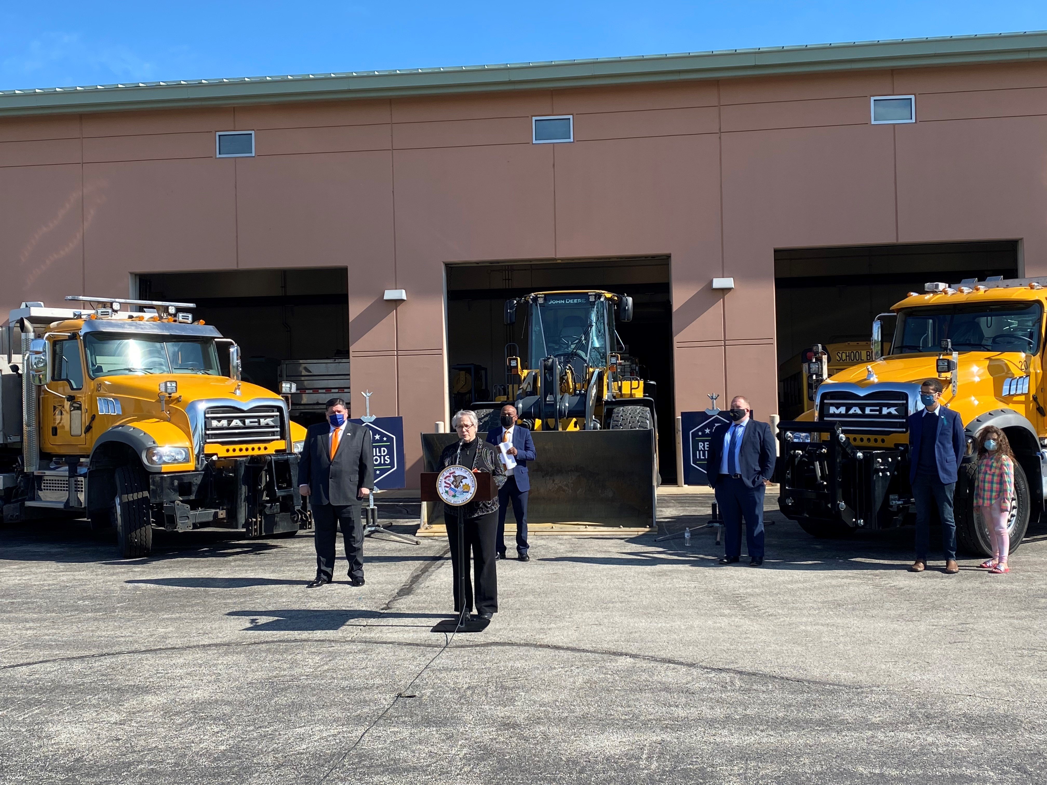
County Government Challenges–
WORKFORCE ! ! !
Nationally – boomer generation is retiring - talent drain of experienced staff
Statewide – population of IL is declining
Locally - recruitment/retention of employees as an employer of choice is more expensive and competitive
Sector - Recruitment/retention of elected and appointed officials in all districts of local government
Maintenance costs for SAS (software as a service) as county upgrades IT
County facility maintenance
County land use issues
  urban annexation
  wind farms
  deteriorating highway and drainage infrastructure

Slide 12
The bottom line…
County level government is responsible for the county’s vital and property records, elections, public services for unincorporated areas of the county, tax collection for all local governments and the justice system.
People want quality services.
People want to pay only what is necessary to make this happen.
We are expected to be:
Accurate
Cooperative
Effective
Efficient
Fair
Thrifty

Slide 13
Positive foundation –
Pandemic recovery –
  Businesses have continued to adjust with changing conditions, business income shifted among sectors – hardest hit sectors were hospitality/entertainment and growth was experienced in on-line services and construction.
  Local governments did not experience revenue losses as great as anticipated.
  Individuals shifted to on-line service options and remote/flexible work – this is likely to continue where possible.
Champaign County has maintained its population count, unlike surrounding counties and the state as a whole.
We have established working relationships among our local governments, non-profits and businesses that help us problem-solve.
ARPA funding has given us some room to catch up with deferred expenses.

Slide 14
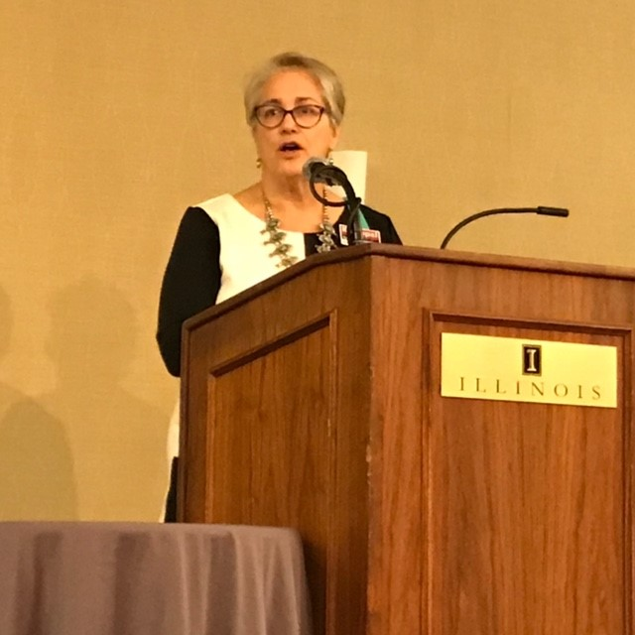
Specific recommendations -
Clarify the county’s form of governance
Reduce the size of the board to 15-17 with one representative per district
Re-introduce orientation for all county elected & appointed officials
Nurture constructive problem-solving
Identify 1-2 shared goals each year that the board can move forward
Make better use of the county’s budgeted partnerships to meet strategic goals
Build maintenance and replacement costs into county budgets from the beginning

