Slide 1

C-U
FRESH START
A Focused Approach to Deter Gun Violence

Slide 2
City of Champaign
City of Urbana
City of Rantoul
Champaign County Administrator
University of Illinois
Champaign Co. State’s Attorney
Champaign Co. Sheriff’s Office
Champaign Co. Mental Health Board
Champaign Unit 4 School District
Urbana School District #116
Champaign Park District
Urbana Park District
C-U Public Health District
United Way of Champaign County

Slide 3
C-U Fresh Start Steering Committee
Patricia Avery, Director, Champaign-Urbana Area Project
Anthony Cobb, Police Chief, Champaign Police Department
Domonic Cobb, Associate Dean of Students, University of Illinois
Rev. Willie G. Comer Jr., Executive Director, East Central Illinois Youth for Christ
Patrick Connolly, Chief of Police, City of Urbana
Joe Gordon, Director, Probation & Court Services, Champaign County
Charlene Haynes-James & Scott James
Diane Marlin, Urbana City Council
LaEisha Meaderds, Asst to Police Chief for Community Services, Champaign Police Department
Rev. Rickey Parks, Pastor, Pilgrim Missionary Baptist Church
Tracy Parsons,Community Relations Manager/Compliance Officer, City of Champaign
Julie Pryde, Public Health Administrator, Champaign-Urbana Public Health District
Gail Raney, COO, Prairie Center Health Systems
Julia Rietz, State's Attorney, Champaign County
Joan Walls, Deputy City Manager, City of Champaign

Slide 4
What is C-U Fresh Start?
Community-led, focused effort to deter gun violence which gives individuals a choice to stop shooting and move in a different direction.

Slide 5
Why should we try this approach?
“Gun violence devastates families, damages neighborhoods, and endangers the community. We’ve had enough. It has to stop now.”

Slide 6
Gun violence endangers EVERYONE.
February 2015 to February 2016:
125 verified incidents of gunfire
3 young men killed
Over 25 young men injured
Over 160 innocent people in homes and vehicles were endangered

Slide 7
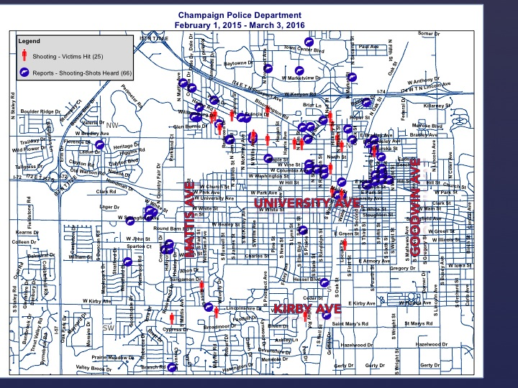
CHAMPAIGN SHOOTINGS

Slide 8
URBANA SHOOTINGS
URBANA POLICE DEPARTMENT
FEBRUARY 13, 2015 – FEBRUARY 12, 2016

Slide 9

Focused deterrence has a record of success
Boston, MA
Minneapolis, MN
Richmond, CA
High Point, NC
Peoria, IL
and elsewhere

Slide 10
Community
Voices
Law Enforcement
C-U
FRESH
START
Service Providers

Slide 11
THREE PILLARS OF C-U FRESH START
Community Voices
Describe impact of gun violence
Family and friends of victims
Family and friends of core offenders
Religious leaders
Funeral directors
ER doctors
Neighborhood residents
Former offenders
Elected officials

Slide 12
THREE PILLARS OF C-U FRESH START
Law Enforcement
Work with Steering Committee to identify core offenders using objective criteria
Age 18 or older
On parole or probation
Prior felony arrest
Prior gun arrest or a violent crime conviction
Credible information of recent involvement in violent crime

Slide 13
THREE PILLARS OF C-U FRESH START
Service Providers
Case manager will be available to help core offenders:
Identify needs
Access services and resources
Address immediate personal or family issues
Reduce barriers to employment, housing, education, etc.

Slide 14
“CALL IN”
WITH CORE OFFENDERS
PART ONE
Law Enforcement Officials
Clearly state consequences for gun violence and inform offenders of law enforcement response
Community Voices:
Victims’ families and friends describe impact of gun violence
Former offenders share experience and perspective
Service Providers
Offer access to services and resources
Mental health or medical referrals

Slide 15
“CALL IN”
WITH CORE OFFENDERS
PART TWO
CORE OFFENDERS CHOOSE
Gun violence
End gun violence
Law enforcement response
Service providers response,
if requested

Slide 16
MEASURING PROGRESS
Decrease number of shooting incidents
Reverse the upward trend in gun violence
Document core offender outcomes
Increase community awareness and participation

Slide 17
Community
Voices
Law Enforcement
C-U FRESH
START
Support Services & Resources

Slide 18

C-U
FRESH START
A Focused Approach to Deter Gun Violence
CONTACT: Tracy Parsons
PHONE: 217-403-8830
EMAIL: tracy.parsons@ci.champaign.il.us

