Slide 1
ANNUAL IDOT TRAFFIC STOP DATA
CHAMPAIGN POLICE DEPARTMENT
URBANA POLICE DEPARTMENT
CHAMPAIGN COUNTY SHERIFF’S OFFICE
UNIVERSITY OF ILLINOIS POLICE DEPARTMENT
TOPICS
TRAFFIC STOP NUMBERS BY RACE
CITATION RATES BY RACE
CONSENT SEARCHES BY RACE
DOG SNIFFS BY RACE

Slide 2
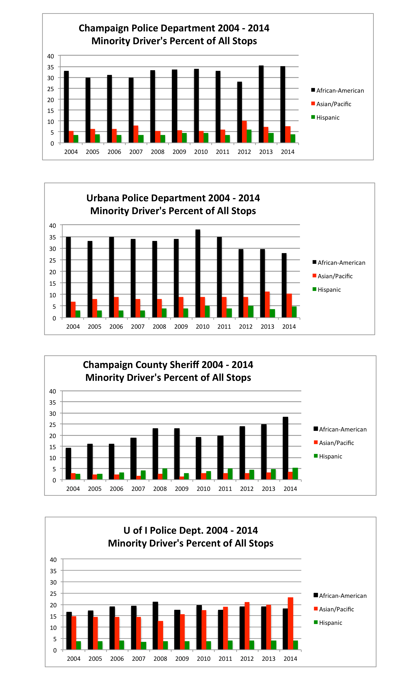
2004 – 2014 TRAFFIC STOPS OF MINORITY DRIVERS
African-American drivers are the only racial driving group whose percent of stops exceeds their percent of the driving public in all geographical areas by all four law enforcement departments.
All other racial driving groups, (Caucasians, Hispanics, and Asian/Pacific), are stopped at rates equal or less than their percent of the driving public, with the single exception of Asian/Pacific drivers on campus the last five years.
Even though Urbana’s stop percentage for African-American drivers has trended down the past four years, both Champaign’s and Urbana’s stop numbers are close or exceed twice what one would statistically expect. African-American drivers in these two cities compose 14%-17% of the driving public, but 28% -35% of the stops.
Even though the County Sheriff and U of I Police Department stops of African-American drivers are typically lower than 20%-25%, it is unlikely African-American drivers compose more than 10% of the driving public in the county or on campus.
To understand why these disparities may exist, the County Racial Justice Task Force may want to read Urbana’s IDOT Task Force’s recently completed report.

Slide 3
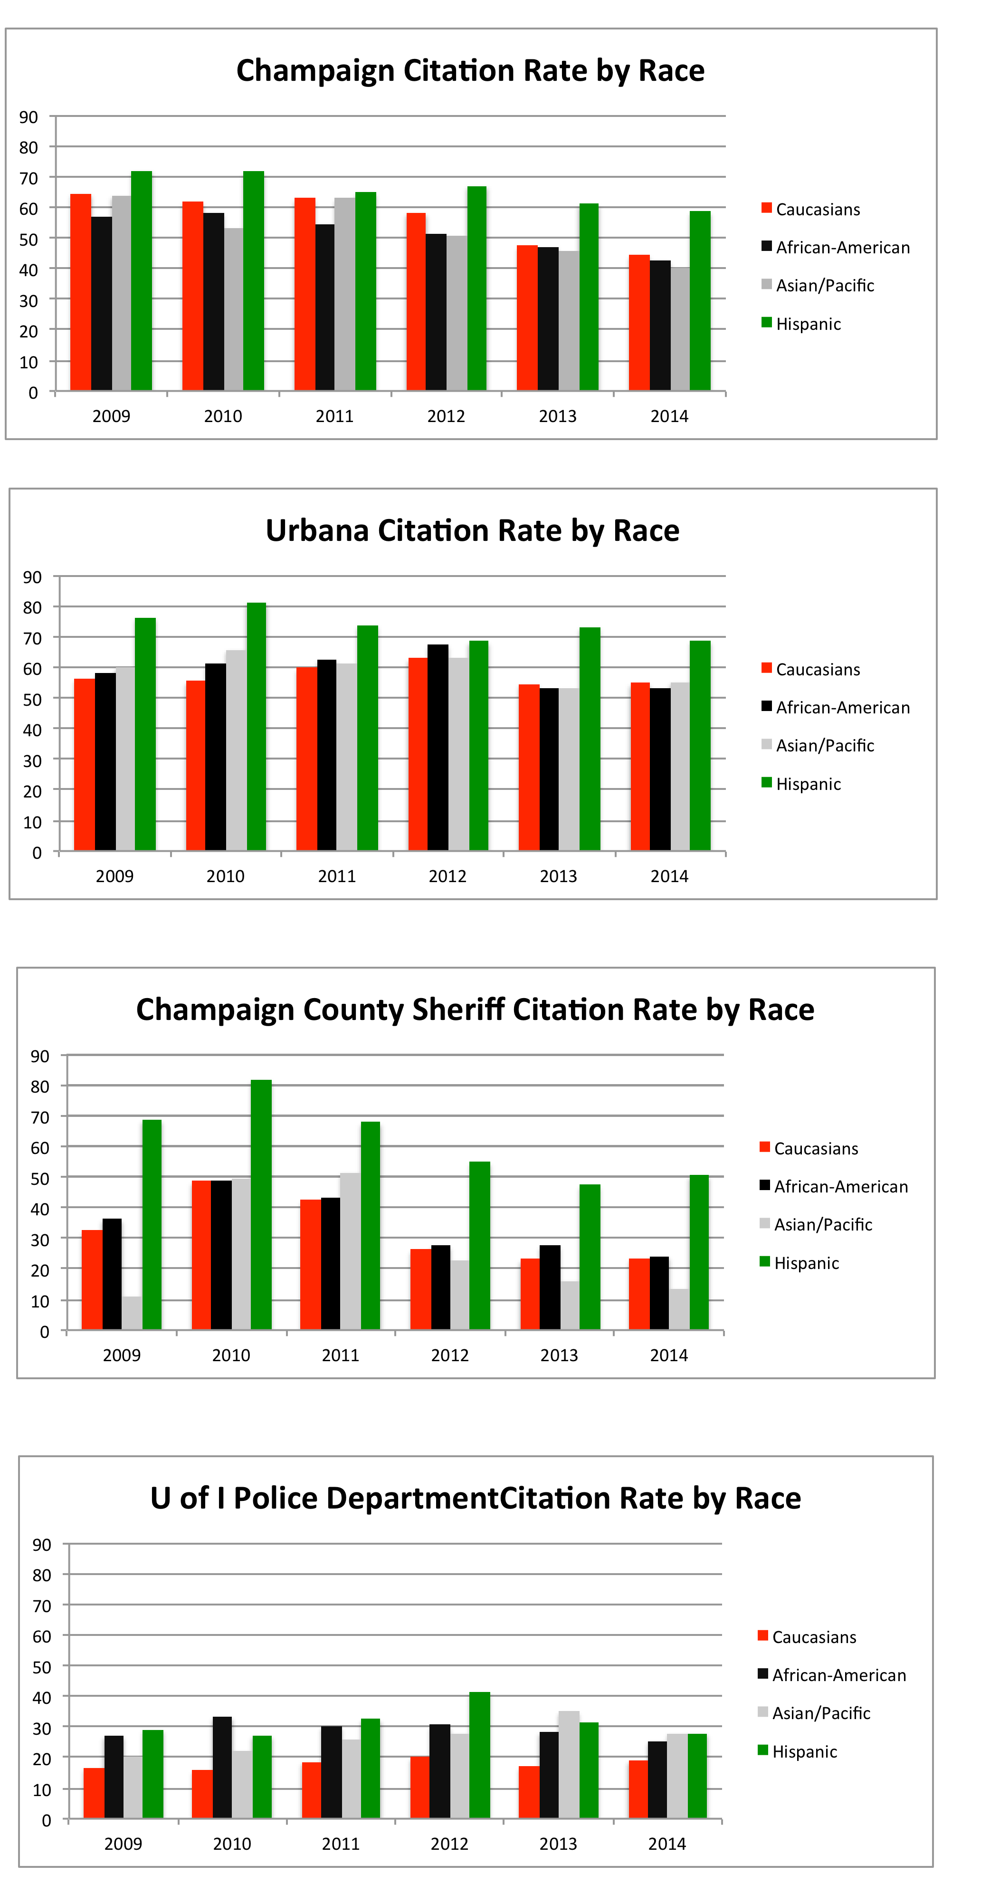
2004 – 2014 CITATION RATES BY RACE
Although not stopped disproportionately to their percent of the driving public, Hispanics are consistently given tickets by each of the four police departments at a higher rate than any other racial driving group.
Champaign and Urbana Police Departments give citations at higher rates than the Sheriff’s Department or the U of I Police Department, typically more than 50% of stopped drivers receive a ticket.
Champaign’s citation rate seems to have dropped steadily the last four years, about 10-15 points. The Sheriff’s Department citation rate has dropped precipitously the last three years.
In any given year, with the exception of the U of I Police Department, citation rates between Caucasians and African-American drivers do not seem to be statistically significant.
The U of I Police Department has the lowest citation rate for all four groups of drivers, but all three minority races are ticketed at higher rates (8-15 points) than Caucasian drivers stopped on campus.

Slide 4
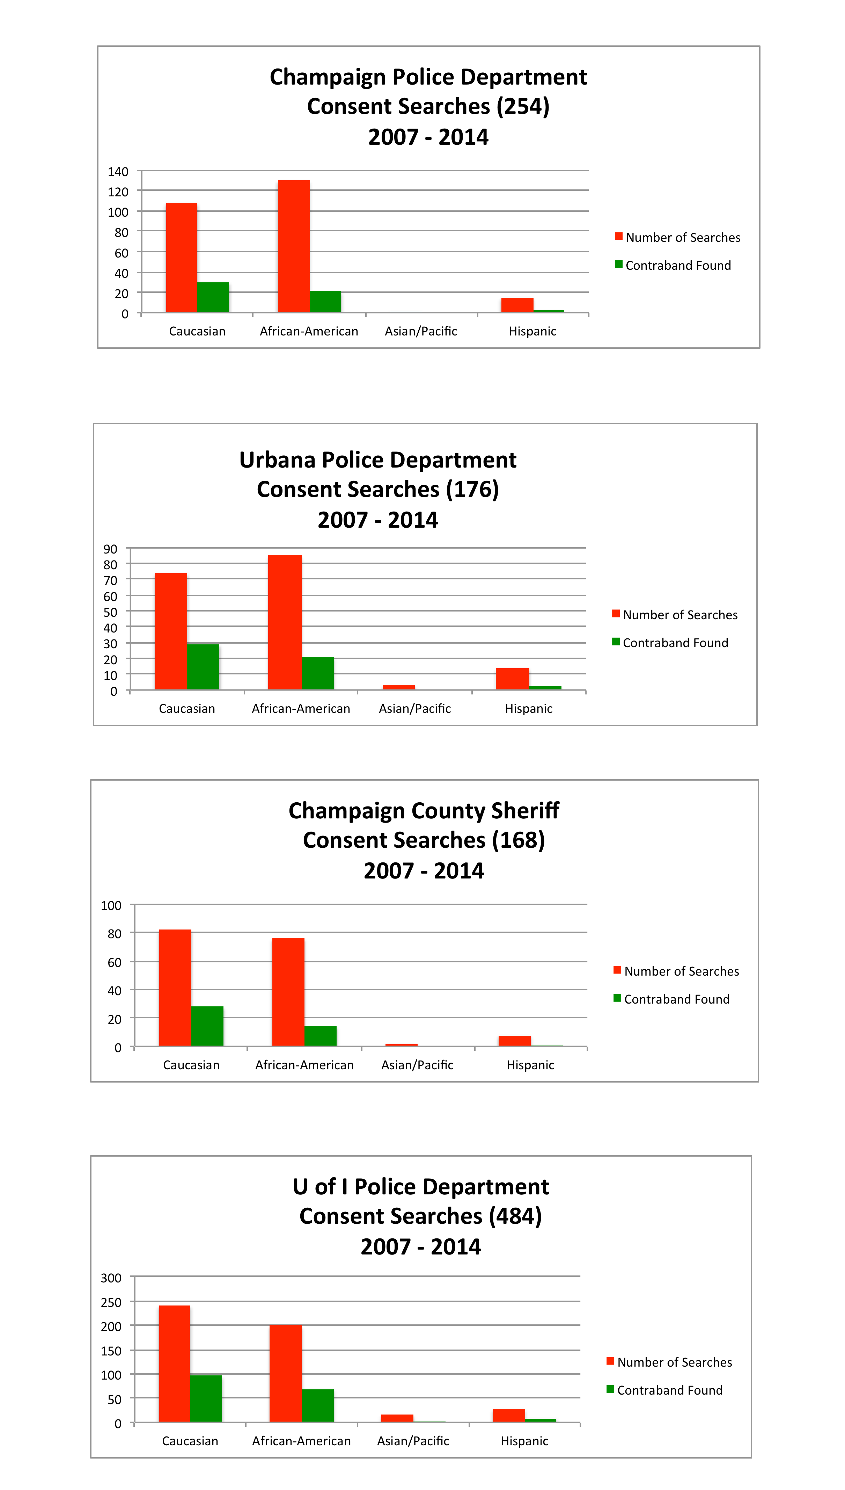
2007 – 2014 TRAFFIC STOP CONSENT SEARCHES
The use of consent searches during traffic stops does not constitute a large number compared to the overall stops made each year by each police department.
Never-the-less, consent search numbers can be informative when evaluated by race.
Compared to other races, African-American drivers are subjected to consent searches of their vehicle in highly disproportionate numbers. Numbers often exceed those for consent searches of Caucasian drivers.
Outcomes of consent searches document that contraband was more often found in cars driven by Caucasian drivers than African-American drivers even though more African-American consent searches occurred.
The effectiveness of consent searches seems to be questionable by the low success rate of finding contraband while subjecting many drivers to a needless intrusive investigation.
The use of consent searches varies greatly between police departments. The U of I Police Department uses it the most (484), and the County Sheriff the least (168).

Slide 5
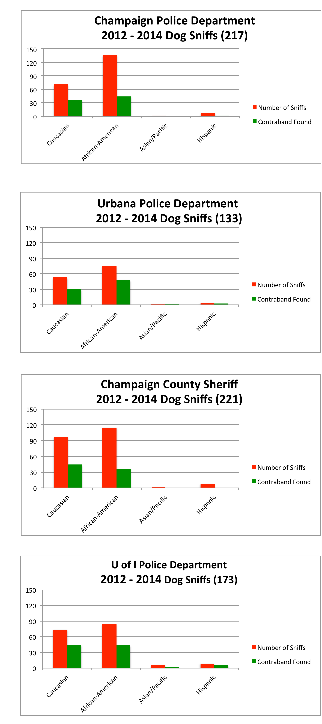
2012 – 2014 TRAFFIC STOPS INVOLVING DOG SNIFFS
In the context of overall traffic stops, dog sniffs are a relatively small number.
However, since data was collected by the state beginning in 2012, one can see that each of the local police departments exercise the use of the canine unit more frequently with African-American drivers than any other racial driving group.
Also as a percent of drivers stopped by race, contraband generally is found less frequently with African-American drivers than with Caucasian drivers.
These two facts may suggest when calling for the canine unit, officers may have a lower threshold of reasonable suspicion or probable cause for African-American drivers than drivers of other races.

Slide 6
Traffic Stop Numbers
The number of traffic stops conducted by local law enforcement agencies can vary greatly from year-to-year. Champaign’s stop numbers, for example, have varied from a high 10,485 in one year to a low of 5309 in another, a difference of 5,176 stops. It is not unusual for any department’s stop numbers to vary by the thousands from any given year.
The public is often unaware that this variance is occurring.
There is no evidence of public traffic safety being compromised when fewer stops are conducted.
The reason for a dramatic change in stop numbers is likely a “emphasis” change on the part of the Chief of Police of each department, but further research would be helpful. Champaign’s has been trending downward the last 3-4 years.
In spite of the fluctuations in the number of stops each year, the racial disparities within those numbers remains relatively unaffected.

Slide 7
IMPACT OF TRAFFIC STOP RACIAL DISPARITIES
Greater Psychological/Emotion Stress
Increased Financial Burden
Strained Police/Community Relations

Slide 8
TWO TYPES OF TRAFFIC STOPS
Police departments typically conduct legal traffic stops for two entirely different purposes.
1. Safety Stops
Traffic stops initiated for the sole purpose of addressing a vehicular traffic code violation.
2. Investigatory Stops
Investigatory stops (pretextual, intrusive and discretionary in nature) initiated to investigate among other things: suspicion behavior, potential crime in the area, or search for contraband.

Slide 9
MORE EVALUATION OF INVESTIGATORY STOPS IS NEEDED
THREE QUESTIONS
1. Do investigatory stops show evidence of being racially biased?
2. Have local investigatory stops actually been shown (documented) to be an effective policing tactic in reducing crime and making our communities safer?
3. Over time do investigatory stops produce unintended consequences that actually harm the community, negatively affect police/community relations, and make it more difficult for law enforcement to do its work effectively?

Slide 10
POLICE LEADERSHIP
IS NEEDED TO ASSESS THE EFFECTIVENESS
AND IMPACT OF INVESTIGATORY STOPS
Every law enforcement agency should be collecting the following data:
whether the stop was a safety or investigatory stop
the reason for initiating an investigatory stop
whether there was an arrest made
the reason for the arrest, (e.g. traffic crime, warrant arrest, drug crime, property crime, or violent or weapons crime).
Every law enforcement Chief should:
Promote the professional norm of not stopping drivers except when justified by clear evidence of criminal behavior. (There must be more than a pretextual reason for conducting a stop.)

Slide 11
JUVENILE JUSTICE
IN
CHAMPAIGN COUNTY
Do Black Youth Receive Equitable Treatment In the Champaign County Criminal Justice System?
COURT RECORDS FROM
JANUARY 1, 2009 THROUGH OCTOBER 31, 2010

Slide 12
Juvenile Demographic Information
Champaign County
2008 U.S. Census Information:
Champaign County Population 193,636 / 100%
Persons under 18 38,533 / 19.9%
Whites under 18 30,094 / 78.1%
Blacks under 18 4,431 / 11.5%
Asians under 18 3,159 / 8.2%
Other 849 / 2.2%

Slide 13
Data Highlights
525 - Total of Open and Closed Juvenile Cases
20.2% (106) total white juvenile cases
73.1% (384) total black juvenile cases
6.7% (35) total “other” race juvenile cases
181 - Open Cases – Disposition Not Yet Determined
19.3% (35) total white juvenile cases
76.3% (138) total black juvenile cases
4.4% (8) total “other” race juvenile cases
344 - Closed Cases – Dispositions Determined
20.6% (71) total white juvenile cases
71.5% (246) total black juvenile cases
7.9% (27) total “other” race juvenile cases
112 - Total Battery & Aggravated Battery Charges
10.7% (12) white battery & aggravated battery charges
82.1% (92) black battery & aggravated battery charges
7.2% (8) other battery & aggravated battery charges
17 - Total Resisting Arrest & Obstruction Charges
00.0% (0) white resisting arrest & obstruction charges
88.2% (15) black resisting arrest & obstruction charges
11.8% (2) other, not identified

Slide 14
60 - Total Felony Convictions
16.7% (10) white felony convictions
73.3% (44) black felony convictions
10.0% (6) other race felony convictions
95 - Total Misdemeanor Convictions
16.8% (16) white misdemeanor convictions
80.0% (76) black misdemeanor convictions
3.2% (3) other race misdemeanor convictions
White vs Black Conviction Rate
36.6% (26/71) of all white juvenile cases result in a felony or a misdemeanor conviction
48.8% (120/246) of all black juvenile cases result in a felony or a misdemeanor conviction
SUMMARY
3.5 of every 1000 white youth faced a criminal charge in Champaign County during this period
86.7 of every 1000 black youth faced a criminal charge in Champaign County during this period
24.8 times more likely for a black youth than a white youth to face a criminal charge

Slide 15
SUMMARY OF CHAMPAIGN COUNTY CLOSED JUVENILE CASES (2008 THROUGH OCTOBER 2009) - PAGE 1
Percentages represent the ratio of the number in the box to the total number of juvenile cases (344) closed during this time period.
RACE | CHARGE - STATUTE DESCRIPTION |  |  |  |  |  |  |  |  |  |  | DISPOSITION
 | Battery & Aggravated Battery | Battery Domestic | Theft | Criminal Sexual Abuse & Assault | Agg. Assault | Resist/ Obstruction | Truant | Drug Related | Burglary | Other | TOTAL | Felony Conviction | Misdemeanor Conviction | Plea Dismissed | VORP Dismissed | MISC Dismissed | Other | TOTAL
White | 12 | 19 | 5 | 6 | 2 | 0 | 1 | 3 | 13 | 10 | 71 | 10 | 16 | 7 | 5 | 31 | 2 | 71
 | 3.4% | 5.5% | 1.4% | 1.7% | 0.6% | 0.0% | 0.3% | 0.9% | 3.7% | 2.9% | 20.6% | 2.9% | 4.7% | 2.0% | 1.5% | 9.0% | 0.6% | 20.6%
Black | 92 | 16 | 30 | 2 | 9 | 15 | 5 | 7 | 28 | 42 | 246 | 44 | 76 | 27 | 28 | 59 | 12 | 246
 | 26.4% | 4.6% | 8.6% | 0.6% | 2.6% | 4.3% | 1.4% | 2.0% | 8.0% | 12.1% | 71.5% | 12.8% | 22.1% | 7.8% | 8.1% | 17.2% | 3.5% | 71.5%
Asian | 1 | 1 | 0 | 0 | 0 | 0 | 0 | 0 | 0 | 0 | 2 | 1 | 0 | 0 | 0 | 1 | 0 | 2
 | 0.3% | 0.3% | 0.0% | 0.0% | 0.0% | 0.0% | 0.0% | 0.0% | 0.0% | 0.0% | 0.6% | 0.3% | 0.0% | 0.0% | 0.0% | 0.3% | 0.0% | 0.6%
Other | 2 | 0 | 0 | 0 | 1 | 0 | 1 | 0 | 1 | 0 | 5 | 2 | 1 | 0 | 0 | 1 | 1 | 5
 | 0.6% | 0.0% | 0.0% | 0.0% | 0.3% | 0.0% | 0.3% | 0.0% | 0.3% | 0.0% | 1.4% | 0.6% | 0.3% | 0.0% | 0.0% | 0.3% | 0.3% | 1.5%
N/A | 5 | 1 | 0 | 0 | 0 | 2 | 1 | 0 | 3 | 8 | 20 | 3 | 2 | 1 | 0 | 1 | 13 | 20
 | 1.4% | 0.3% | 0.0% | 0.0% | 0.0% | 0.6% | 0.3% | 0.0% | 0.9% | 2.3% | 5.8% | 0.9% | 0.6% | 0.3% | 0.0% | 0.3% | 3.8% | 5.8%
TOTAL | 112 | 37 | 35 | 8 | 12 | 17 | 8 | 10 | 45 | 60 | 344 | 60 | 95 | 35 | 33 | 93 | 32 | 344
 | 32.2% | 10.6% | 10.1% | 2.3% | 3.4% | 4.9% | 2.3% | 2.9% | 12.9% | 17.2% | 100.0% | 17.4% | 27.6% | 10.2% | 9.6% | 27.0% | 9.3% | 100.0%

Slide 16
SUMMARY OF CHAMPAIGN COUNTY CLOSED JUVENILE CASES (2008 THROUGH OCTOBER 2009) - PAGE 2
Percentages represent the ratio of the number in the box to the total number of each vertical column found at the bottom.
RACE | CHARGE - STATUTE DESCRIPTION |  |  |  |  |  |  |  |  |  |  | DISPOSITION
 | Battery & Aggravated Battery | Battery Domestic | Theft | Criminal Sexual Abuse & Assault | Agg. Assault | Resist/ Obstruction | Truant | Drug Related | Burglary | Other | TOTAL | Felony Conviction | Misdemeanor Conviction | Plea Dismissed | VORP Dismissed | MISC Dismissed | Other | TOTAL
White | 12 | 19 | 5 | 6 | 2 | 0 | 1 | 3 | 13 | 10 | 71 | 10 | 16 | 7 | 5 | 31 | 2 | 71
 | 10.7% | 51.4% | 14.3% | 75.0% | 16.7% | 0.0% | 12.5% | 30.0% | 28.9% | 16.7% | 20.6% | 16.7% | 16.8% | 20.0% | 15.2% | 33.3% | 7.4% | 20.6%
Black | 92 | 16 | 30 | 2 | 9 | 15 | 5 | 7 | 28 | 42 | 246 | 44 | 76 | 27 | 28 | 59 | 12 | 246
 | 82.1% | 43.2% | 85.7% | 25.0% | 75.0% | 88.2% | 62.5% | 70.0% | 62.2% | 70.0% | 71.5% | 73.3% | 80.0% | 77.1% | 84.8% | 63.4% | 44.4% | 71.5%
Asian | 1 | 1 | 0 | 0 | 0 | 0 | 0 | 0 | 0 | 0 | 2 | 1 | 0 | 0 | 0 | 1 | 0 | 2
 | 0.9% | 2.7% | 0.0% | 0.0% | 0.0% | 0.0% | 0.0% | 0.0% | 0.0% | 0.0% | 0.6% | 1.7% | 0.0% | 0.0% | 0.0% | 1.1% | 0.0% | 0.6%
Other | 2 | 0 | 0 | 0 | 1 | 0 | 1 | 0 | 1 | 0 | 5 | 2 | 1 | 0 | 0 | 1 | 1 | 5
 | 1.8% | 0.0% | 0.0% | 0.0% | 8.3% | 0.0% | 12.5% | 0.0% | 2.2% | 0.0% | 1.5% | 3.3% | 1.1% | 0.0% | 0.0% | 1.1% | 3.7% | 1.5%
N/A | 5 | 1 | 0 | 0 | 0 | 2 | 1 | 0 | 3 | 8 | 20 | 3 | 2 | 1 | 0 | 1 | 13 | 20
 | 4.5% | 2.7% | 0.0% | 0.0% | 0.0% | 11.8% | 12.5% | 0.0% | 6.7% | 13.3% | 5.8% | 5.0% | 2.1% | 2.9% | 0.0% | 1.1% | 48.1% | 5.8%
TOTAL | 112 | 37 | 35 | 8 | 12 | 17 | 8 | 10 | 45 | 60 | 344 | 60 | 95 | 35 | 33 | 93 | 27 | 344
 | 100.0% | 100.0% | 100.0% | 100.0% | 100.0% | 100.0% | 100.0% | 100.0% | 100.0% | 100.0% | 100.0% | 100.0% | 100.0% | 100.0% | 100.0% | 100.0% | 100.0% | 100.0%

Slide 17
RACIAL DEMOGRAPHICS OF THOSE BOOKED INTO THE CHAMPAIGN COUNTY JAIL TAKEN FROM NEWS-GAZETTE WEBSITE
JANUARY 2016
204 Black Males 42%
128 White males 26%
71 Black Females 15%
44 White Females 9%
13 Hispanic males 3%
8 Unknown 2%
6 Arabic 1%
6 Asian 1%
2 Hispanic females
2 Indian
484 total bookings into the county jail
57% 275 African American
35% 172 Caucasian
3% 15 Hispanic
An average of 16 people are booked into the county jail per day.
An average of 9 African Americans are booked into the county jail per day.

Slide 18
FEBRUARY 2016
188 Black males 43%
112 White males 25%
60 Black females 14%
38 White females 9%
21 Hispanic males 5%
12 Unknown 3%
4 Arabic males 1%
2 Asian males
2 Asian female
1 Hispanic female
440 total bookings into the county jail
57% 248 African American
34% 140 Caucasian
5% 22 Hispanic
An average of 15 people are booked into the county jail per day.
An average of 9 African Americans are booked into the county jail per day.

Slide 19
MARCH 2016
191 Black Males 39%
127 White Males 26%
68 White Females 14%
57 Black Females 12%
17 Hispanic Males 4%
9 Asian Males 2%
7 Hispanic Females 1%
4 Unknown
2 Arabic males
1 Indian males
484 total bookings into the county jail
51% 248 African American
40% 195 Caucasian
3% 24 Hispanic
An average of 16 people are booked into the county jail per day.
An average of 8 African Americans were booked into the county jail per day.

Slide 20
TOTALS FOR JANUARY, FEBRUARY, AND MARCH OF 2016
1408 total bookings into the county jail
55% 771 African Americans
37% 517 Caucasians
4% 61 Hispanics

